Slide 1
Descriptive and inferential statistical methodologies have proven effective in creating a proactive ‘alarm’, accurately identifying Pump Failures with Horse Power (HP) and Pump Efficiency (PE) emerging as key variables of interest with deviations of 15 HP and > 3 % PE being our core signal thresholds.

Slide 2
Descriptive Analysis has enabled us to clearly identify particular signature abnormalities showing clear signature changes in both Rolling Standard Deviation and Rolling Mean Datasets when observed over the respective failure period of interest.

Slide 3
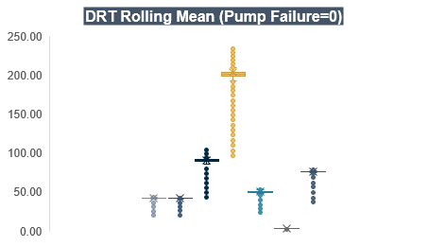
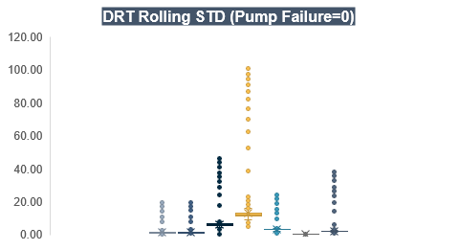
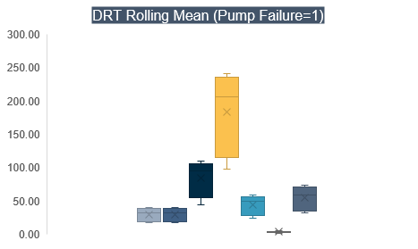
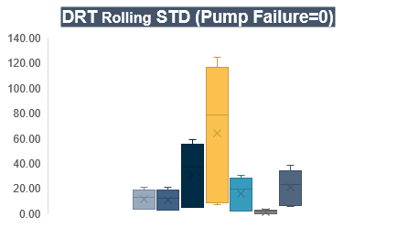
Further segmentation of the data via binary means (Pump Failure = 0 or 1) illustrated through Box & Whisker Plot, show a clear signature difference between that of normal behaviour and that of Failure with Pump Torque, Pump Efficiency, Horse Power showing the 3 largest variances.

Slide 4
Correlation analyses across datasets yield particularly interesting insights with Pump Speed , Pump Torque, Ambient Temp., Volumetric Flow Meter 1 & 2 and Pump Efficiency are negatively correlated with Pump Failure in the Rolling Mean Data, whilst Horse Power, Volumetric Flow Meter 1 and Pump Efficiency show a subsequently strong positive correlation in the Rolling Stdev Dataset.

Slide 5
Lastly, analysis of the statistical significance of variables contributing towards Pump Failure reveal that with a R Squared of 0.78, a linear model is a good fit for the data with both Rolling Mean and Rolling Standard Deviation datasets contributing key information to understand Pump Failure mechanics.
Variable | P-Value Significance
Volumetric Flow Meter 1 | 4.01554437827692E-07
Volumetric Flow Meter 2 | 2.03296768001937E-174
Pump Speed (RPM) | 1.68298540159804E-19
Pump Torque | 1.05511672349945E-102
Ambient Temperature | 4.2051606515157E-09
Horse Power | 3.55241509315848E-219
Pump Efficiency | 2.59198226750818E-152

